Slide 1
바르게 살자
코딩테스트 week2

Slide 2
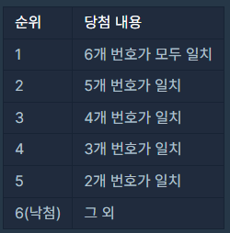
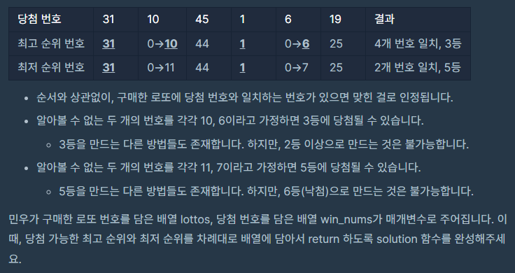
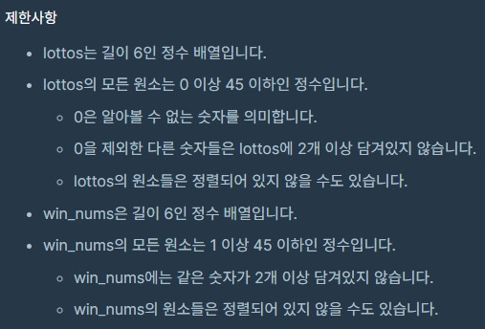
로또의 최고 순위와 최저 순위

Slide 3
로또의 최고 순위와 최저 순위
CODE
BEST CODE
def solution(lottos, win_nums):
cnt = 0
dict = {0:6, 1:6, 2:5, 3:4, 4:3, 5:2, 6:1}
joker = lottos.count(0)
for num in lottos:
if num in win_nums:
cnt += 1
print(joker, cnt)
if cnt == 0 != joker:
joker-=1
answer = [dict[cnt]-joker, dict[cnt]]
return answer
def solution(lottos, win_nums):
rank=[6,6,5,4,3,2,1]
cnt_0 = lottos.count(0)
ans = 0
for x in win_nums:
if x in lottos:
ans += 1
return rank[cnt_0 + ans],rank[ans]

Slide 4
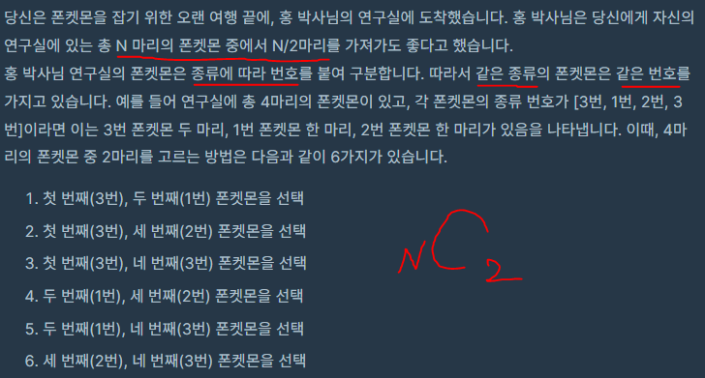
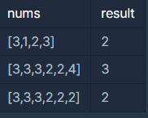
폰켓몬

Slide 5
폰켓몬
CODE
BEST CODE
def solution(nums):
choice = len(nums)//2
answer = max_class = len(set(nums))
if choice <= max_class:
answer = choice
return answer
def solution(ls):
return min(len(ls)/2, len(set(ls)))

Slide 6
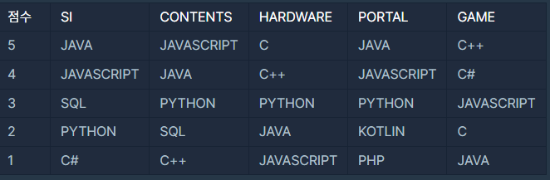
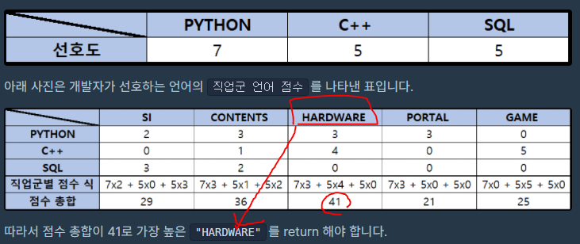
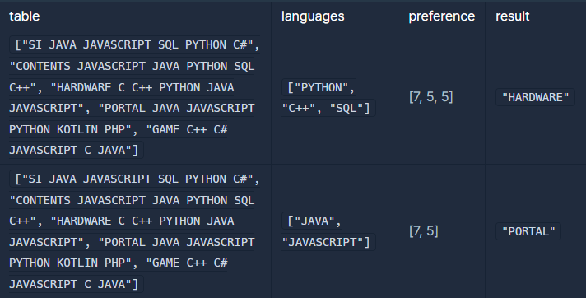
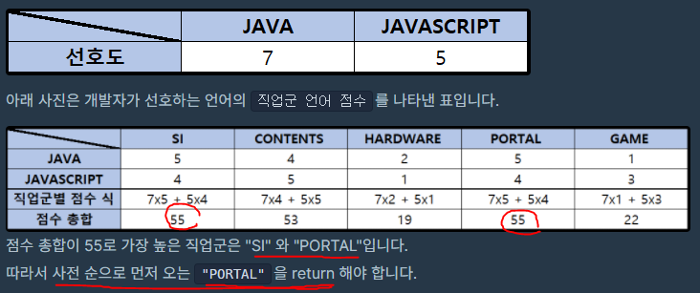
4주차 직업군 추천하기

Slide 7
4주차 직업군 추천하기
CODE
BEST CODE
def solution(table, languages, preference):
answer = dict()
for idx, job in enumerate(table):
table_split = job.split(" ")
score = [0] * 6
for lang, weight in zip(languages, preference):
if lang in table_split:
k = table_split.index(lang)
score[k] = (6-k)*weight
print(sum(score))
answer[table_split[0]] = sum(score)
answer = sorted(answer.items(), key=lambda x: (-x[1], x[0]))
return answer[0][0]
def solution(table, languages, preference):
score = {}
for t in table:
for lang, pref in zip(languages, preference):
if lang in t.split():
score[t.split()[0]] = score.get(t.split()[0], 0) + (6 - t.split().index(lang)) * pref
return sorted(score.items(), key = lambda item: [-item[1], item[0]])[0][0]

